Slide 1
Nuclear Medicine
Radiopharmaceutical chemistry

Slide 2
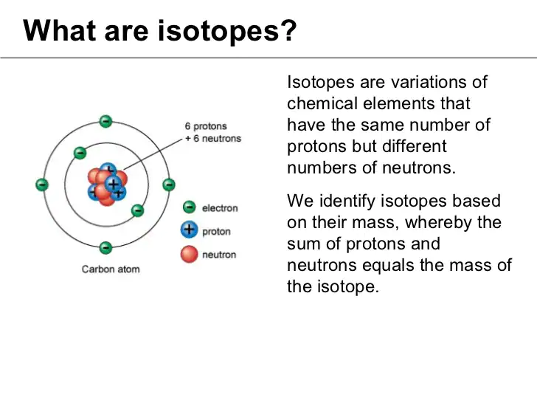

Slide 3
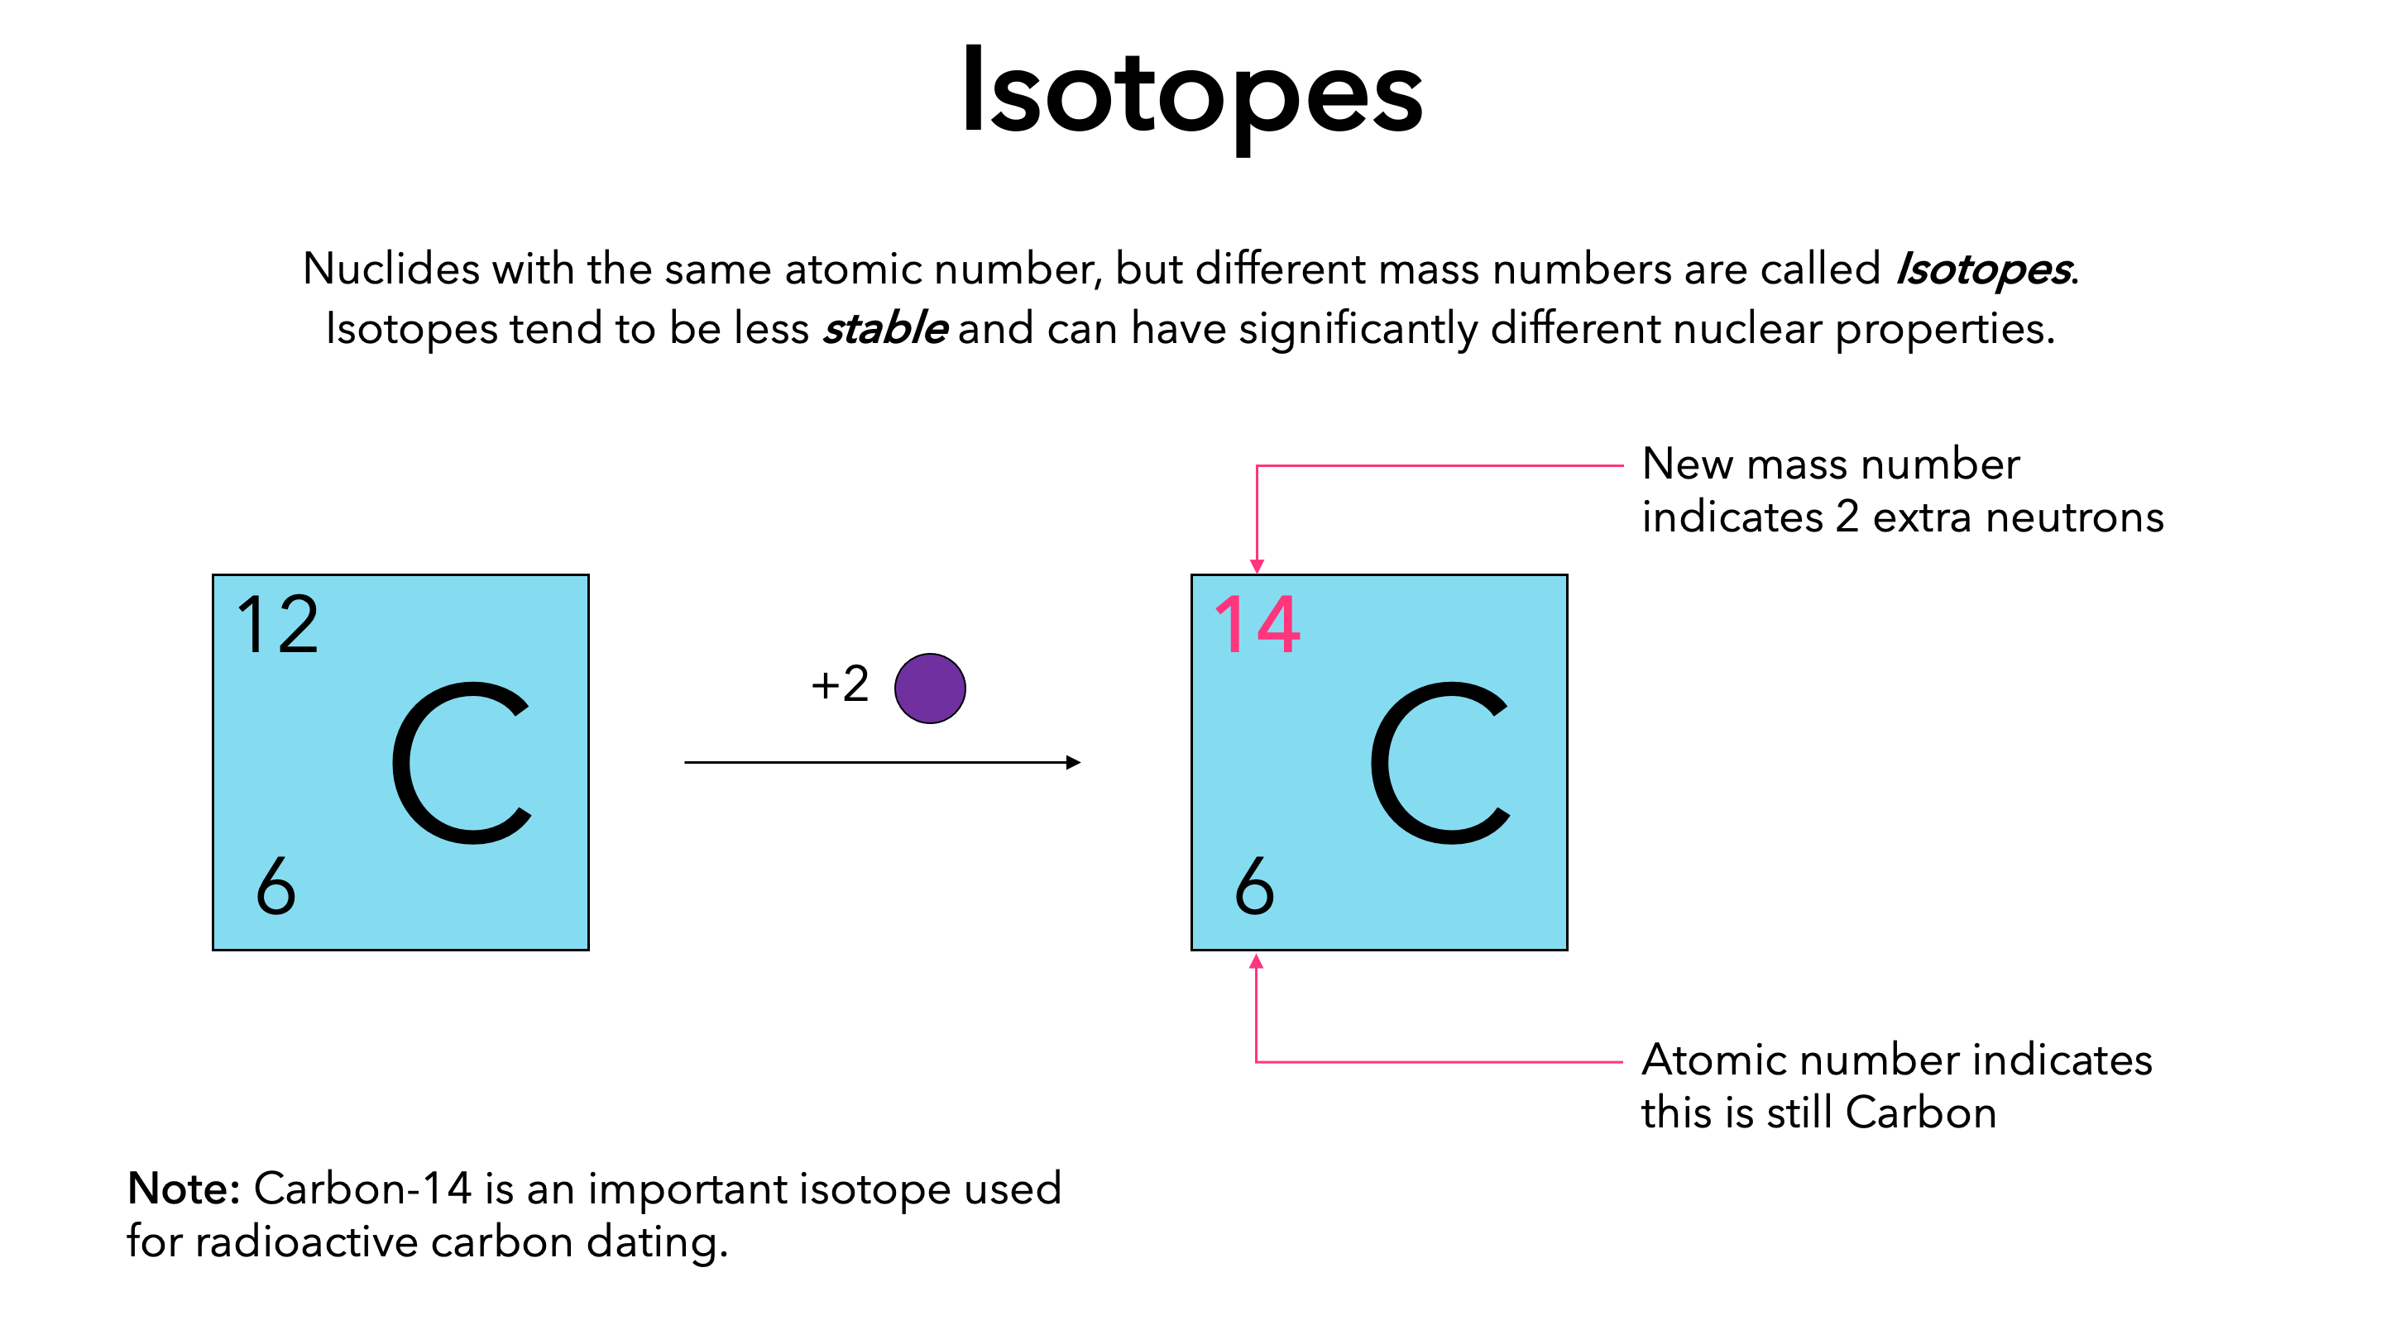

Slide 4
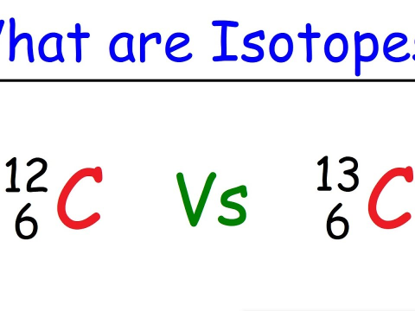

Slide 5
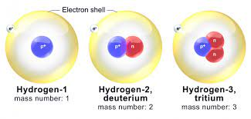
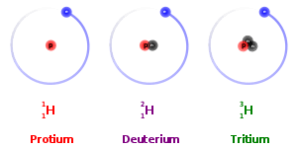

Slide 6
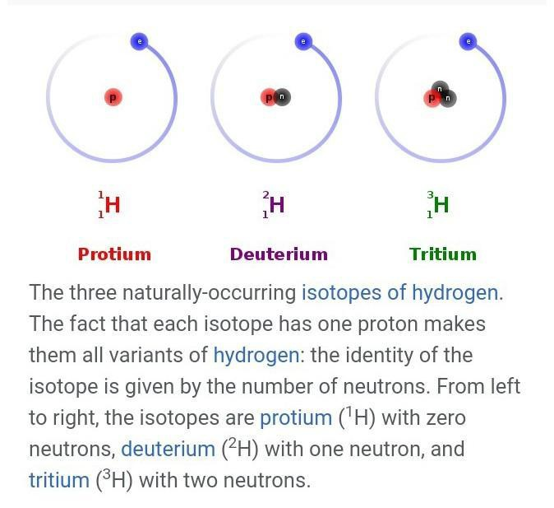

Slide 7
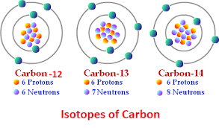
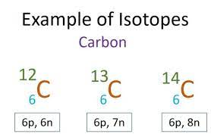

Slide 8
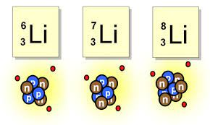

Slide 9
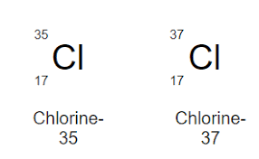

Slide 10
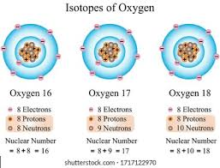

Slide 11
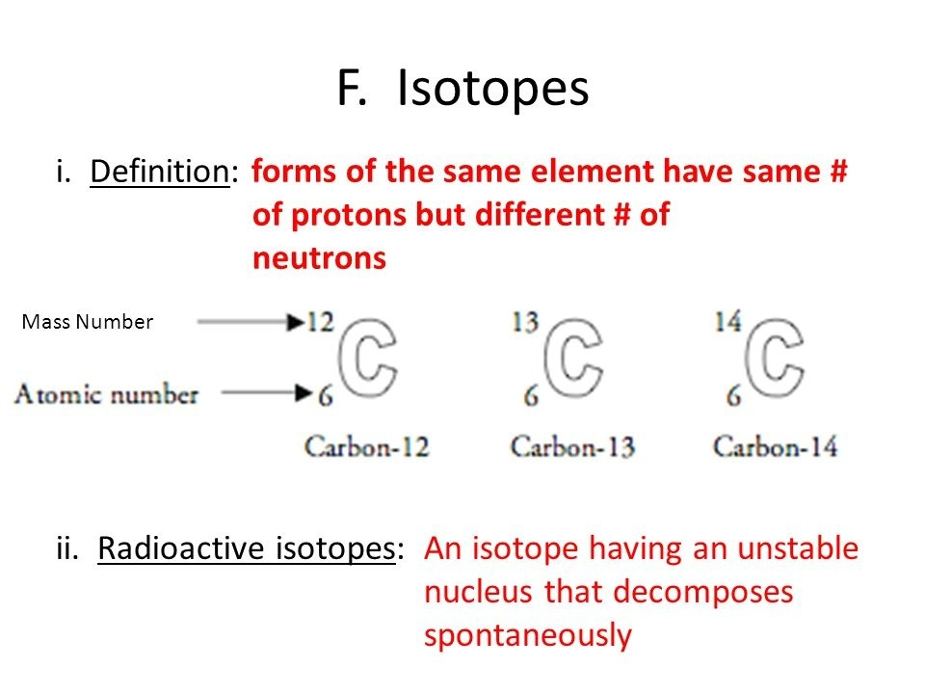

Slide 12
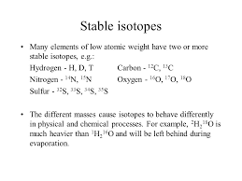

Slide 13
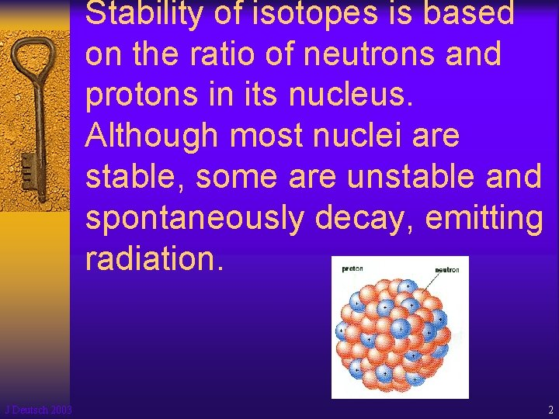

Slide 14
Balance = Stability
One of the things noted in early studies of the nucleus was the dominance of EVEN numbers of nucleons in stable nuclei. There are far more stable nuclei with EVEN numbers of nucleons than with odd numbers of nucleons. For example:
There are 159 stable nuclei with an EVEN number of protons and an EVEN number of neutrons.
There are 53 stable nuclei with an EVEN number of protons and an odd number of neutrons.
There are 50 stable nuclei with an odd number of protons and an EVEN number of neutrons.
There are 4 stable nuclei with an odd number of protons and an odd number of neutrons, and these are in nuclei lighter than oxygen and all exist in that part of the “Path of Stability” that is built using the “Deuteron Step.

Slide 15
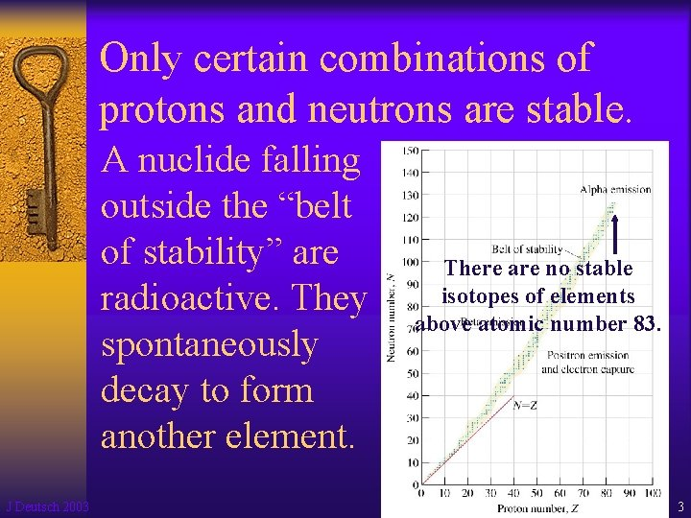

Slide 16
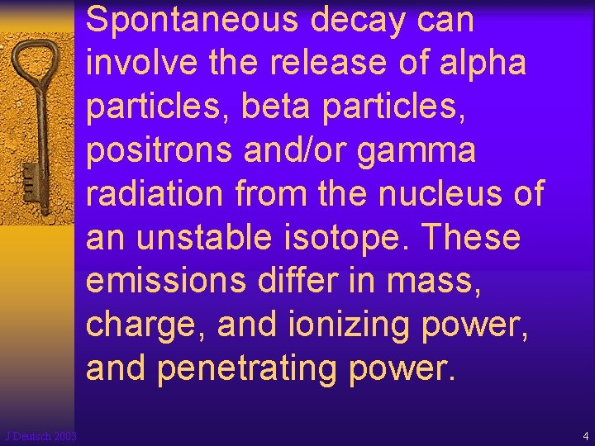

Slide 17
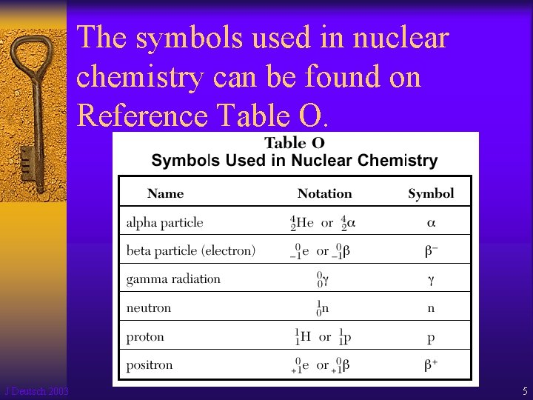

Slide 18
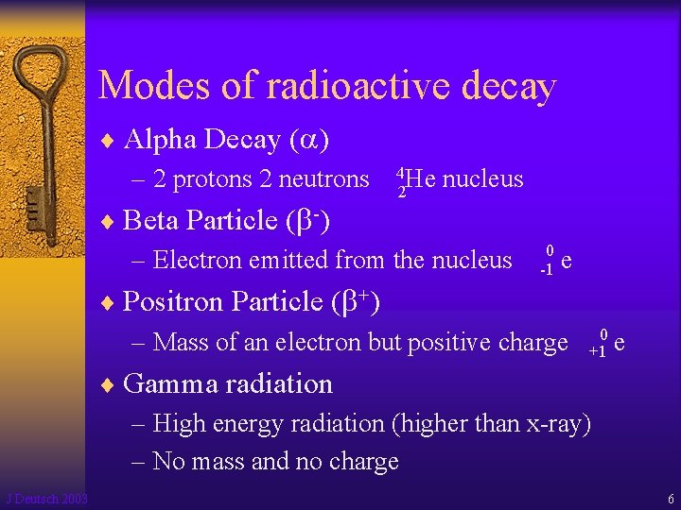

Slide 19
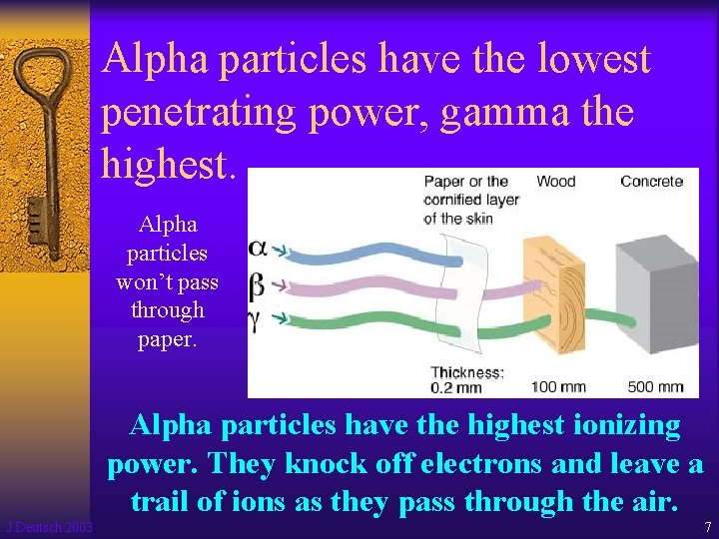

Slide 20
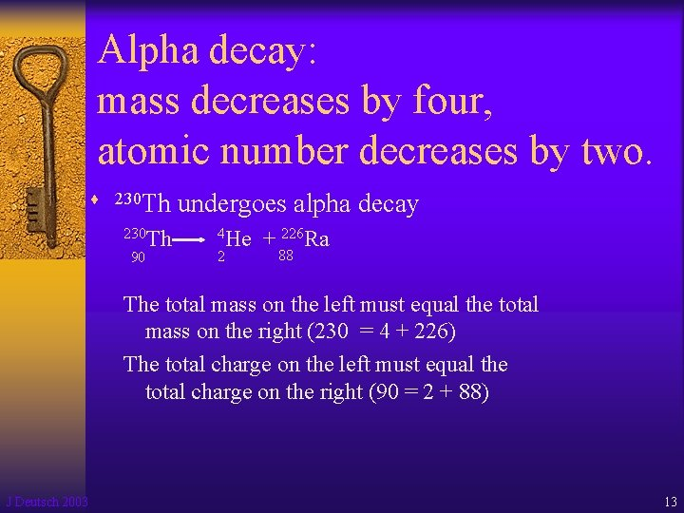

Slide 21
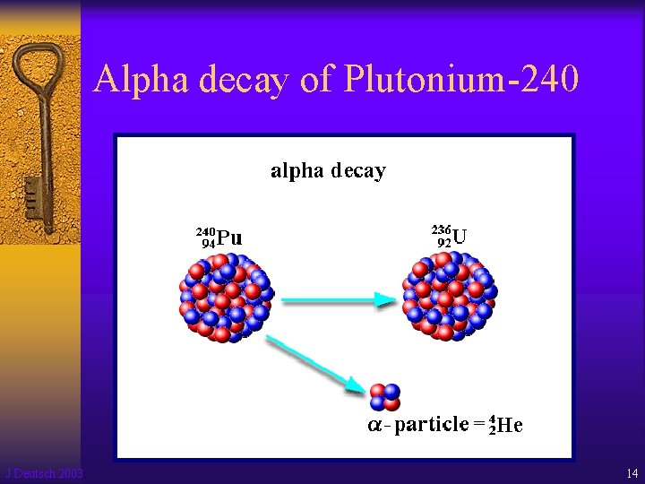

Slide 22
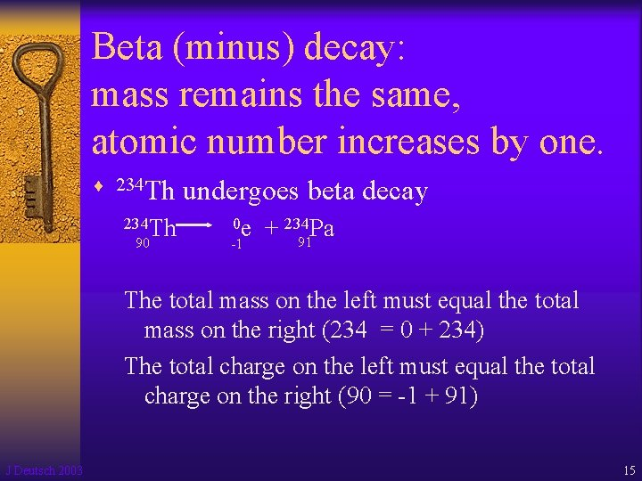

Slide 23
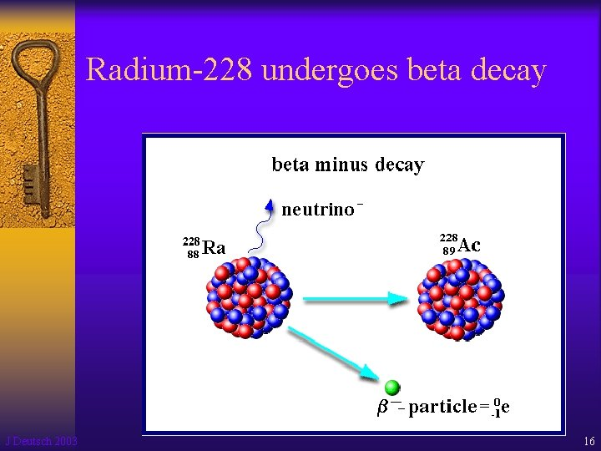

Slide 24
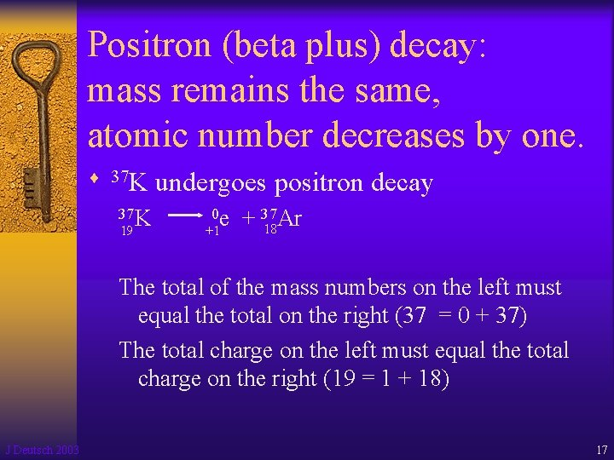

Slide 25
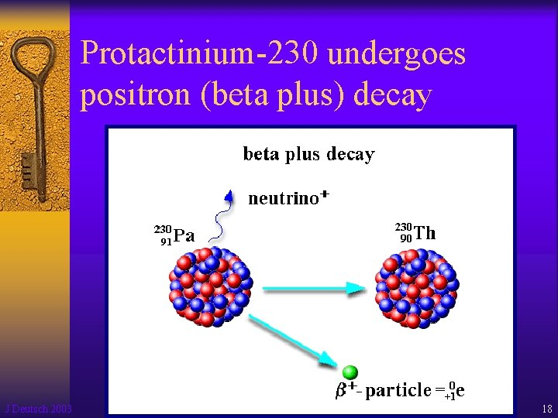

Slide 26
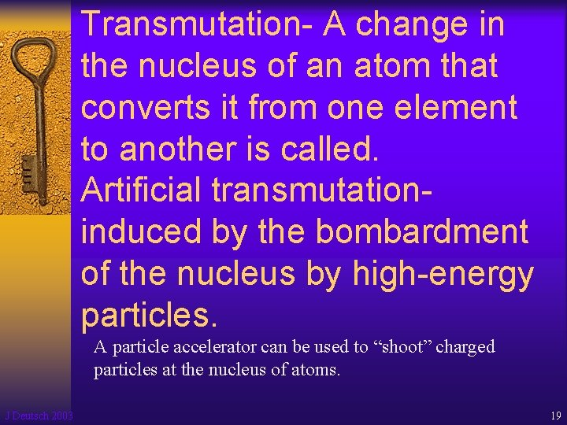

Slide 27
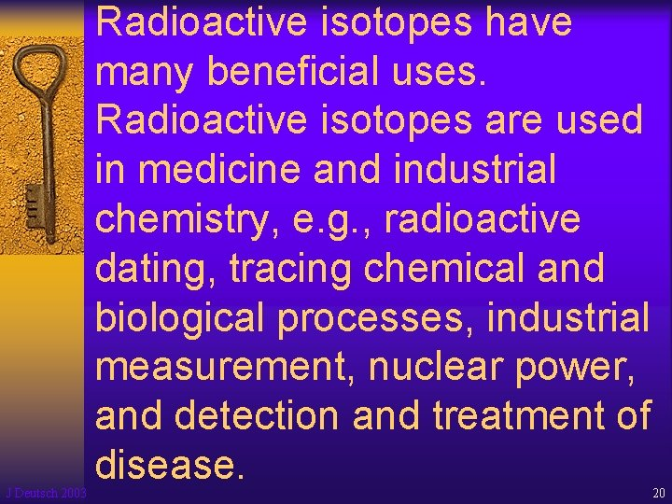

Slide 28
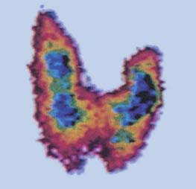
An image of a thyroid gland obtained through the use of radioactive iodine.

